Slide 1
Introducing Pythagoras’ Theorem
Notes:
Possible resources
http://www.scootle.edu.au/ec/viewing/L6559/index.html

Slide 2
Warm Up (LHS)
Write your summary from the last lesson.
What is the sum of the interior angles of a triangle?
What is the length of the missing side?
13m
y
12m

Slide 3
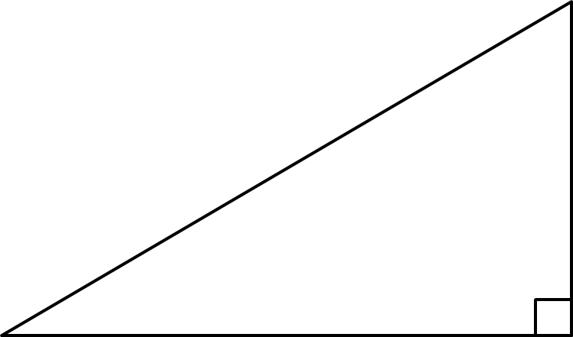
24
7
30
Topic: Right-Angled Triangles
Date
EQ – What is special about right-angled triangles?
What is a right-angled triangle?
A right-angled triangle is a triangle with one angle that is 90º.
The long side is called the hypotenuse.

Slide 4
Activity
Draw this right-angled triangle in you’re the middle of the LHS of your book. Measure out the shorter sides carefully.
Measure the length of the longest side using a ruler.
3cm
4cm
Notes:
Or use 1cm graph paper

Slide 5
A Jigsaw to Try
A Jigsaw to Try
Count the squares near each side.
What patterns do you see?
Count the squares near each side.
What patterns do you see?
Notes:
We are trying to get them to see that the number of total number of squares against the shorter sides is the same as the number of squares ne

Slide 6
24
7
30
Topic: Right-Angled Triangles
Date
EQ – What is special about right-angled triangles?
What is a right-angled triangle?
A right-angled triangle is a triangle with one angle that is 90º.
c
a
b
The long side is called the hypotenuse.
We can label this side as ‘c’
and the other sides as ‘a’ and ‘b’.
What is the rule for the sides?
a² + b² = c²
This is called Pythagoras’ Theorem

Slide 7
We Do
Use Pythagoras Theorem to test if this is a right angled triangle.
10 cm
6cm
8cm
a² + b² = c²
LHS: 8² + 6²
= 64 + 36
= 100
RHS: 10²
= 100
= LHS
Yes it is a right angled triangle

Slide 8
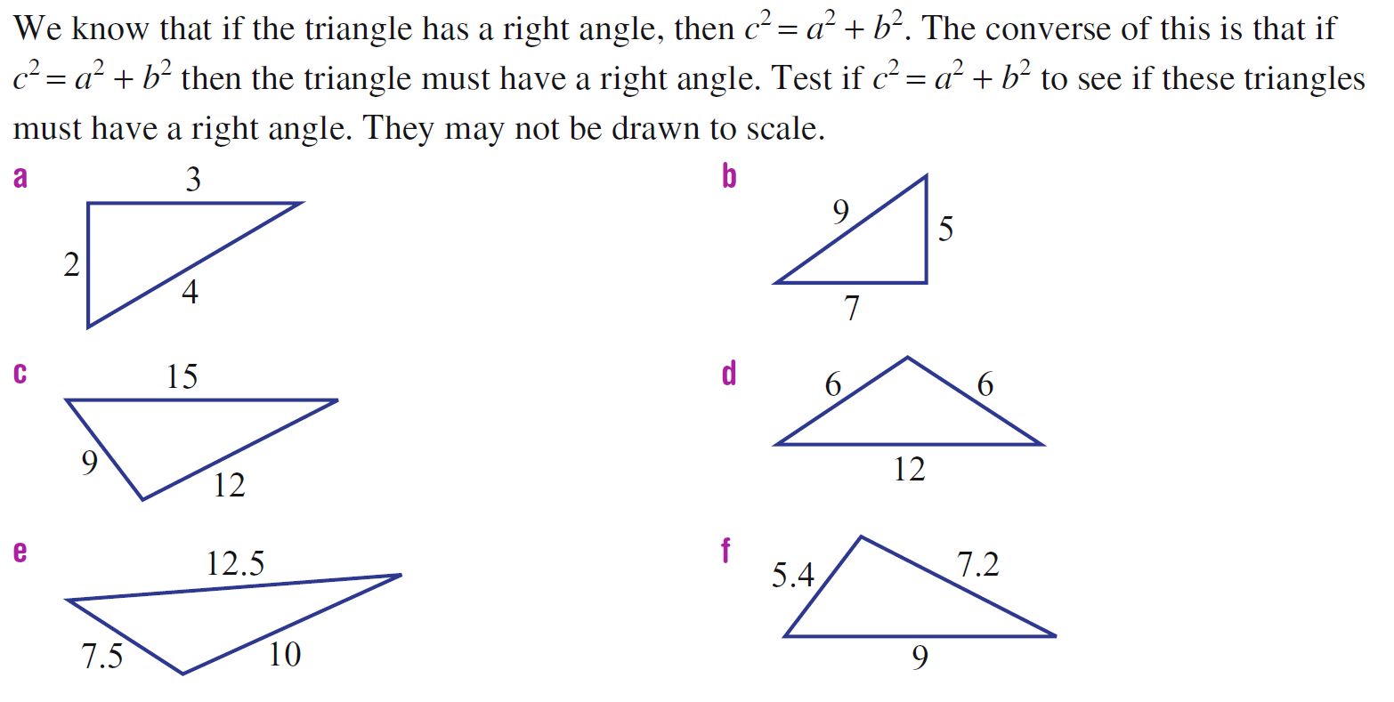
You Do

Slide 9
24
7
30
Topic: Right-Angled Triangles
Date
EQ – How can we work out the sides of right-angled triangles?
Summary
The longest side of a right-angled triangle is called _________________.
To work it out when we know the two shorter sides we use __________________ which is written as ______ + ________ = __________.
Our final step is to calculate the square root of the sum.

